Slide 1
Energy Sector Cybersecurity – ENISA activities
9th International Energy Conference " Energy and Cyber Security – Risks and Protections“
Konstantinos Moulinos, ICT cybersecurity expert, ENISA
11
2
2021

Slide 2
Why is it more complicated?
Roles and responsibilities at the state level
Real time requirements
Complex networks and services
Interdependencies on other sectors
New technologies: new potential avenues of attack
The IT/OT problem

Slide 3
State of play - energy
ENERGY SECTORS ATTACKS 2020*
Attacks against power girds are increasing
NISD review
New areas: power generation, electricity market operators, hydrogen etc
Size threshold instead of identification
More harmonized security requirements and incident reporting
ECI Directive review (CER Directive)
Network code cyber security for the electricity (end 2021)
Smart Grid Task Force report with recommendations to EU COM (2019)
ENISA has provided input to the consultation (May 2020)
Consultation is on going (currently informally)
*Based on the analysis of 100 attacks in the context of EE-ISAC
Energy specificities
Real-time requirements
Cascading effects
Mixture of legacy and stet-of-the-art technology
Commission Recommendation of 3.4.2019, on cybersecurity in the energy sector, C(2019) 2400 final
Notes:
CER=Critical Entities Resilience

Slide 4
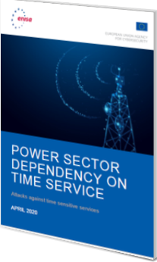
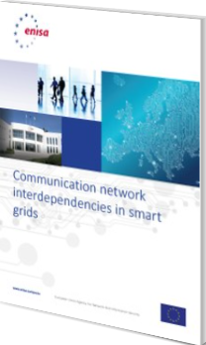
Role of enisa in the energy sector
Build the strategic relationship with DG ENER, ACER, ENTSO-E, E.DSO
Follow up and influence the policy making
Awareness raising
ENTSO-E
EU DSO associations
ACER
Organising Exercises
Advising on policy development and implementation
NIS Cooperation Group WS 8
CEER
Providing knowledge
Supporting information sharing

Slide 5
challenges
Collaboration with the private sector is missing from the NISD
Gaps in the governance (national and EU level)
Small and medium (majority of DSOs) operators are not in scope of the NISD
Responsible disclosure of vulnerabilities
Gaps in coordination during crisis
Insufficient overview of the big picture as per the threat landscape and early warning capability
Dependencies on other sectors are not taken into account

Slide 6
Thank you for your attention
Vasilissis Sofias Str 1, Maroussi 151 24
Attiki, Greece
+30 28 14 40 9711
info@enisa.europa.eu
www.enisa.europe.eu

