Slide 1
The Cyber Security of Energy Systems:
EU Approach and Recommendations
9th International Energy Conference, Bulgaria
Dr. Stephan Lechner, EC, DG ENER

Slide 2

New Commission
2019-2024
“A Union that strives for more”
President
Ursula von der Leyen
A European Green Deal
An economy that works for people
A Europe fit for the digital age
Protecting our European way of life
A stronger Europe in the world
A new push for European democracy

Slide 3
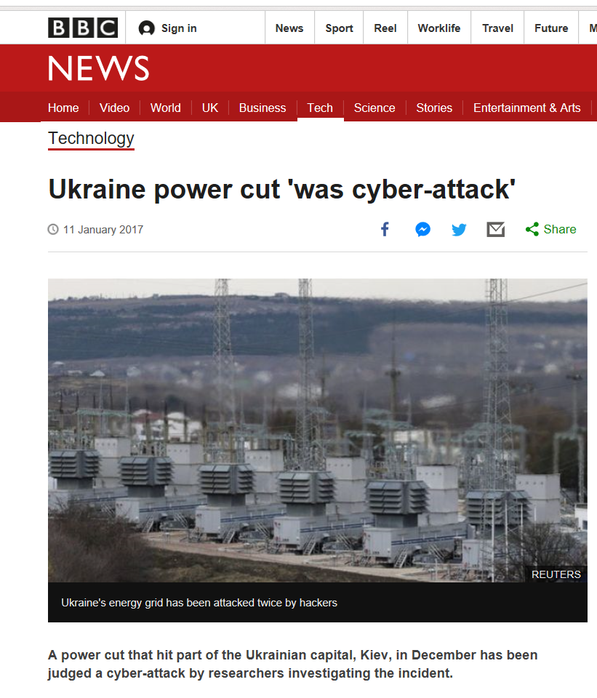
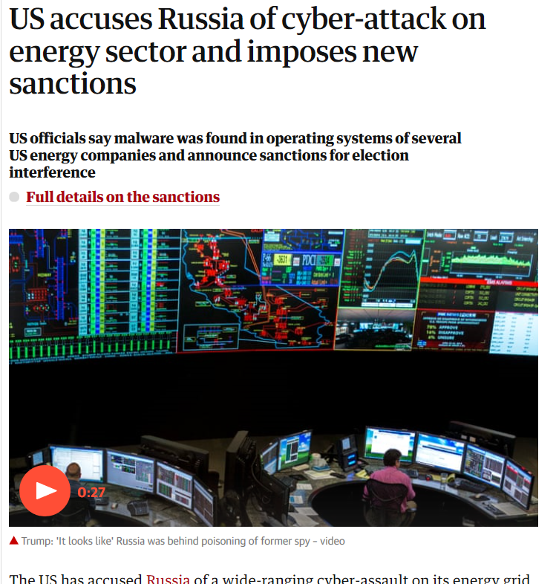
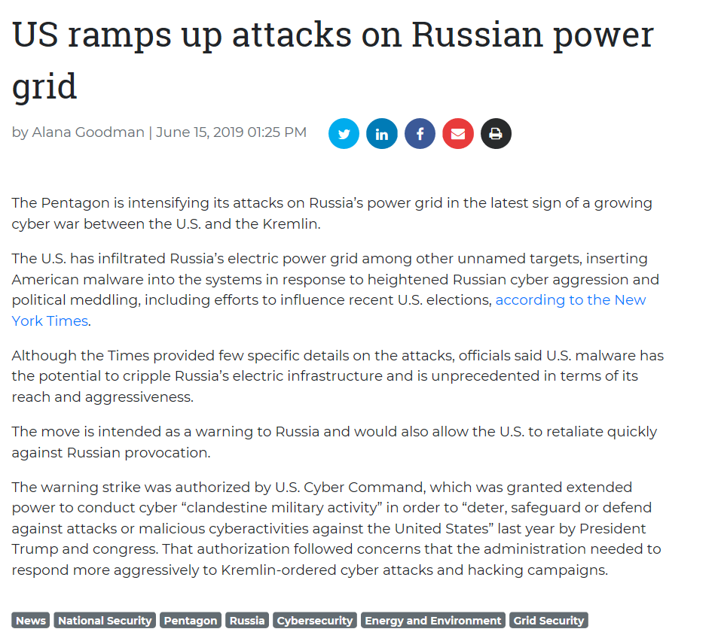
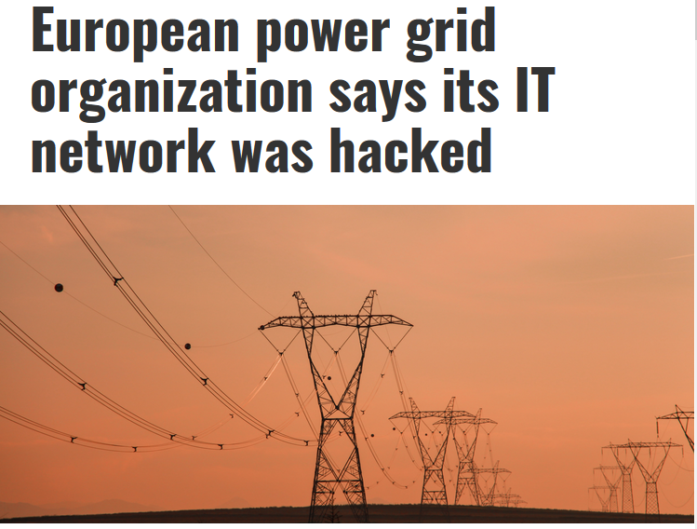
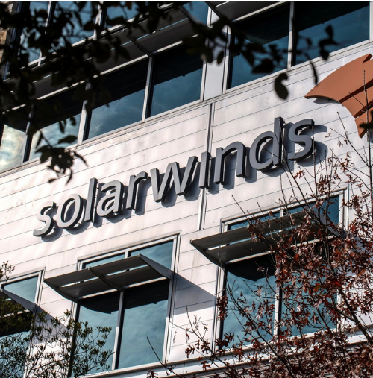
News of January 2017…
March 2018…
June 2019…
March 2020…
December 2020…
…to be continued.

Slide 4
Main elements to date
2019
Cybersecurity in Energy
Commission Recommendation (EU) 2019/553 on cybersecurity in the energy sector
Electricity Regulation
(EU) 2019/943
Risk Preparedness Regulation
(EU) 2019/941
2020 Cybersecurity Package
Directive on the Resilience of Critical Entities
NIS 2.0*
New Cybersecurity Strategy
* NIS 2.0: new energy subsectors, including electricity production, nominated electricity market operators, electricity market participants providing aggregation, demand response or energy storage services; district heating and cooling; oil central stockholding entities, hydrogen
2021
Formal start
Network Code
Start development Network Code for cyber security aspects of cross-border electricity flows
tbc.

Slide 5
Network Code on cybersecurity
Electricity Regulation (EU) 2019/943, Article 59 (2) empowers the Commission to adopt a delegated acts supplementing this Regulation in accordance with Article 68 concerning the establishment of network codes in respective areas.
For cybersecurity the Article 59 (2) (e) foresees sector-specific rules for cyber security aspects of cross-border electricity flows, on common minimum requirements, planning, monitoring, reporting and crisis management.

Slide 6
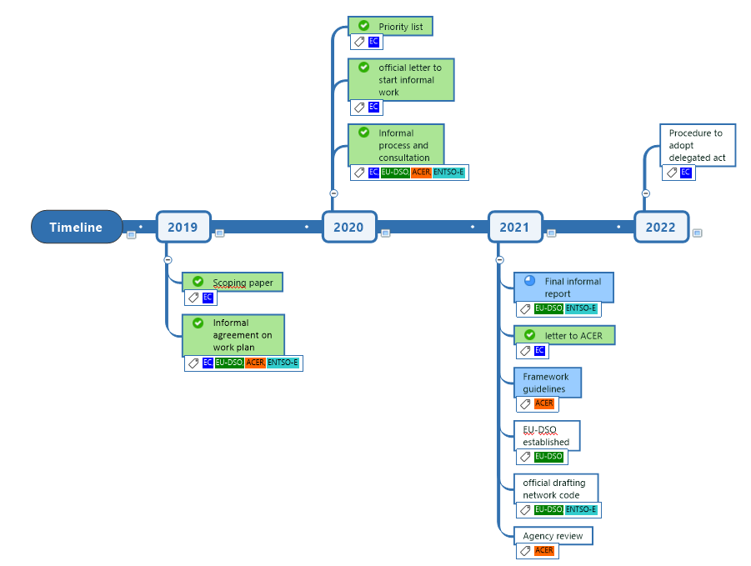
Network Code on cybersecurity

Slide 7

Thank you
More info on
https://ec.europa.eu/energy/topics/energy-security_en
© European Union 2020
Unless otherwise noted the reuse of this presentation is authorised under the CC BY 4.0 license. For any use or reproduction of elements that are not owned by the EU, permission may need to be sought directly from the respective right holders.

