Slide 1
Cybersecurity treatment practices at
AES Bulgaria
Olivier Marquette

Slide 2
Agenda
Cyber at full speed
  Global risks
  Global examples
  IT and OT go hand in hand
  Cybersecurity is an issue of Safety
AES Response/ Strategies
  In terms of administration
  In terms of practical actions
AES Bulgaria
  Implementation of Cybersecurity by design
  Cybersecurity is managed centrally for IT and OT
  Readiness and Compliance with Local and Regional legislation

Slide 3
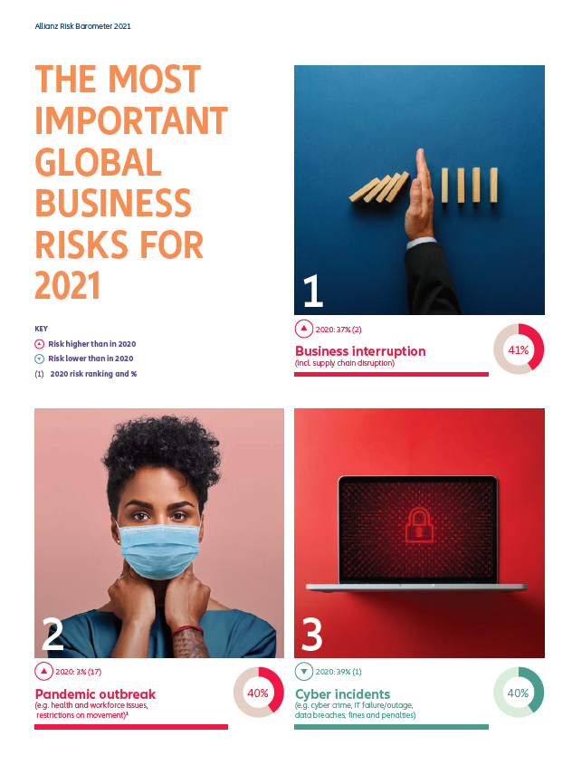
Risk and Cyber
  Cybersecurity risk is #3 out of top 5 business risks worldwide*
Business interruption
Pandemic outbreak
Cyber incidents
Market developments
Changes in regulation and legislation
Beginning of 2020 Cybersecurity related risks were ranked #1 before Covid 19 pandemic crisis
* Allianz Risk Barometer 2021

Slide 4



Risks come true
  Examples of Cybersecurity Incidents
French distiller shares fell as much as 2.1 percent to an intraday low of 116.9 euros in Paris after news of the attack.
Aluminum producer Norsk Hydrohas been cyber attacked that paralyzed its IT systems.
The attack is estimated to have total cost of the attack is set to be 63.5 million-$75.0 million.
Nivea-maker Beiersdorf AG said that an IT disruption caused about 35 million euros ($41 million) in lost sales in the first half.
https://www.datacenterknowledge.com/security/pernod-ricard-maker-absolut-vodka-suffered-cyberattack-london
https://www.insurancejournal.com/news/international/2019/07/24/533763.htm

Slide 5
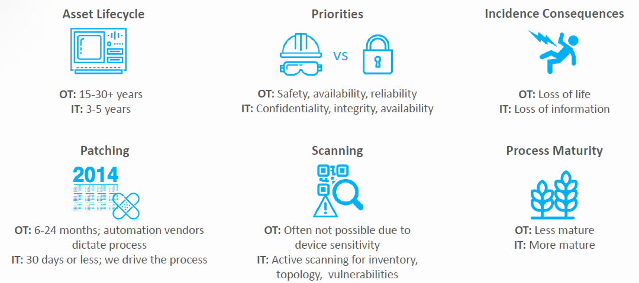
IT and OT - the challenge in a picture
  IT and OT go hand in hand still are different

Slide 6

Cybersecurity protects people
  Cybersecurity is a Safety issue
Cybersecurity attacks when successful have effect on the whole community or even country:
Lives
Healthcare
Major utilities – water, electricity, air
Transportation
Communication
Privacy

Slide 7
AES Response
Administrative efforts - AES Global Cybersecurity policy
Developed in partnership with Global leading consultants
Covering all Cybersecurity domains
  Patch management
  Vulnerability management
  Awareness and trainings
Focus is the same for Operational and Informational Cybersecurity
Dedicated Cybersecurity Manager role
Aligned with European legislation
  ENISA - European Union Agency for Network and Information Security
  NIS Directive
  EU Cybersecurity Act
  GDPR
Aligned with corresponding ISO standards (ISO 27000)

Slide 8
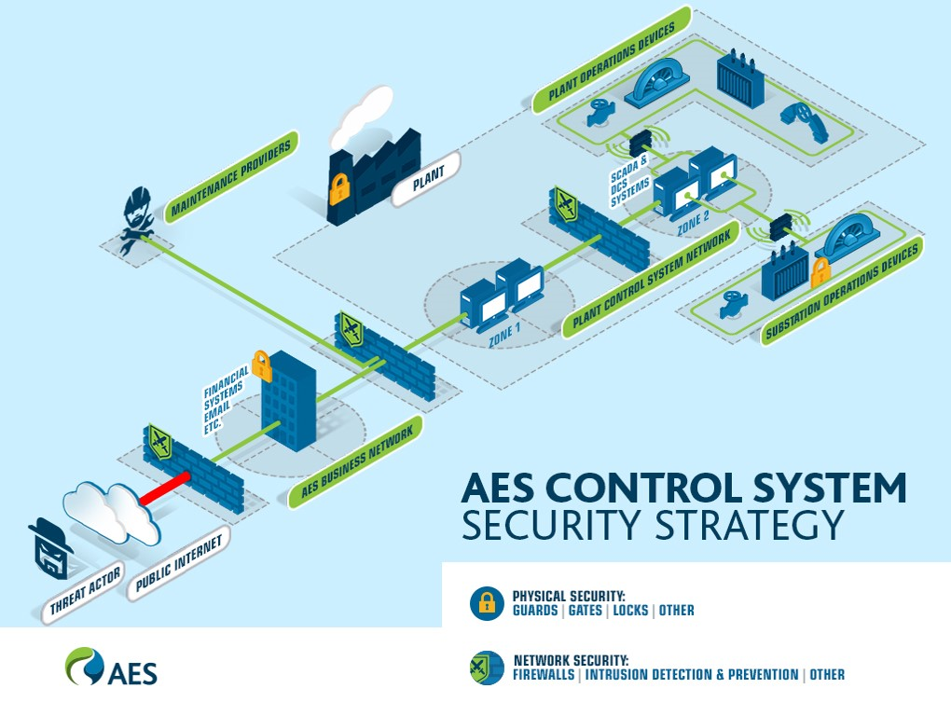

AES Response
By design
Practical efforts - AES Global Cybersecurity program
Security Operations Center – 24/7 monitoring
Cybersecurity by design
Annual Internal and External audits
Annual Penetration tests
Patch management and Vulnerability management
Enterprise toolsets and devices
Cybersecurity awareness program
  Phishing trainings and functionalities
  Global Safety day
  Online training program

Slide 9
AES Bulgaria
Full alignment with AES Global Cybersecurity program plus:
Cybersecurity at all organizational levels
  Senior country management
  Plant management
  Department leads
  Dedicate role for a Centralized Cybersecurity manager
Any new implementations follow best practices
Activities related to alignment with MIMIS (МИМИС – Минимални изисквания за мрежова и информационна сигурност)
  External dedicated audit – gap analysis
  Alignment with governmental partners
  Cybersecurity Roadmap (gap closing)
  Monitoring and Control

