Slide 1

An Integrated Platform for Increased FLEXIbility in smart TRANSmission grids with STORage Entities and large penetration of Renewable Energy Sources
Project presentation

Slide 2







Agenda
The Project
Objectives
Technical Framework
Demonstrations
Impact and Exploitable Results
The Partners

Slide 3


About FLEXITRANSTORE
Project Grant Agreement No. 774407
Budget: 21.7 M Euro
Grant: 17 M Euro
Start: 1 Nov 2017 (M1)
End: 31 Oct 2021 (M48)
LCE-04-2017 call: Demonstration of system integration with smart transmission grid and storage technologies with increasing share of renewables
This project has received funding from the European Union’s Horizon 2020 research and innovation programme under grant agreement No 774407

Slide 4
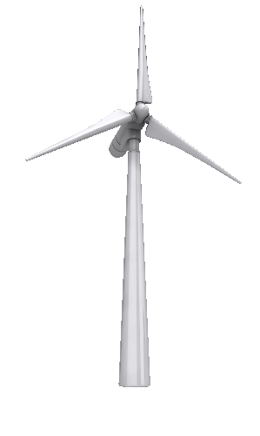

Objectives
To enhance and accelerate the integration of renewables into European energy systems, especially addressing imbalances
STRATEGIC OBJECTIVES
To increase cross border electricity flows across Europe
At a technical level:
→Develop a next generation of Flexible Energy Grid (FEG), which provides the technical basis to support the valorization of flexibility services, enhancing the existing European Internal Energy Market (IEM)
At a market level:
→ A wholesale market infrastructure and new business models should be upgraded to network players, incentivize new ones to join, while demonstrating new business perspectives for cross border resources management and energy trading
Notes:
Renewable energy is a growing component of electricity grids around the world due to its contributions to
energy system decarbonization,
long-term energy security, and
expansion of energy access to new energy consumers in the developing world. However, the integration of large shares of renewables remains a challenge today.
This is due to the fact that they are variable and less predictable in their output which is even worse in terms of the limitation in storing energy in large quantities.
On the other hand the renewables variability and unpredictability impacts the energy market, in terms of the dynamic pricing and flexible trading among market participants.
Future energy frameworks post 2020 will need to be based on an enhanced electricity market design and be fit for the full integration of renewables ....

Slide 5

Specific Objectives
FLEXITRANSTORE Project aims to increase Flexibility:
1
Across the Energy Industry Value Chain:
Integrating Battery Energy Storage Systems (BESS) at different grid connection points: TSO/DSO border substations and Wind Farms and synchronous Gas Turbine Plants
In the transmission grid:
Power Flow Controllers for the first time in the SEE region, Dynamic Line Rating (DLR) sensors and algorithms, efficient controllers for active substations at the TSO/DSO border and Wind Power Plant (WPP) connections to High Voltage networks
2
3
In the distribution grid:
Enhancing demand-response mechanisms using the TSO/DSO controller
4
At conventional generators:
Installation of Power System Stabilizers (PSS), development of a representative grid model at plant level
5
Within the wholesale electricity markets:
Integrated market platform based on an enhanced EUPHEMIA market model

Slide 6
Technical Framework
FLEXITRANSTORE Project will implement technologies and novel concepts aiming to:
Create a pan-European energy Market under a common framework free of national restrictions and legislative barriers imposed by individual nations.
Integrate the South Eastern European energy markets, where market coupling activities are progressing slowly.
“Touch” different grid flexibility resources: improved operations, grid modernization, demand response, fast ramping supply, energy storage.

Slide 7
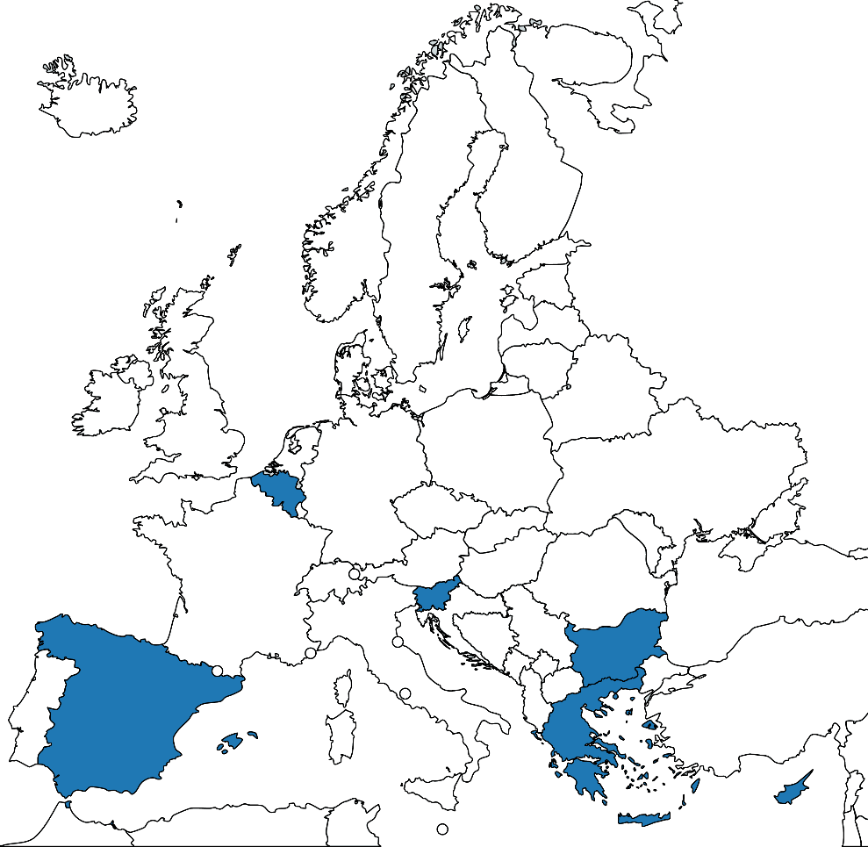
Demonstrators
FLEXITRANSTORE will create 8 demonstrations in 6 countries.
The demonstrators are divided into three layers, according to their application point across the energy value chain.
Layer 1: Flexibility at transmission connection points: Production and demand.
Layer 2: Increasing cross border capacity and clean energy flows.
Layer 3: Flexibility entering the market.
Notes:
Read the slide

Slide 8
Demonstrators
Active Substation Controller with storage integration at the TSO/DSO interface (site: Cyprus)
Active Substation Controller with storage integration at the Wind Park Plant Substation (site: Northern Greece)
Dynamic Line Rating technology (sites: Slovenia, North Eastern Bulgaria)
Power Flow Control devices – Power Line Guardian (sites: Southern Bulgaria, Southern Greece)
Wholesale market demonstration and clearing (sites: Bulgaria, Cyprus)
Active Substation Controller in Hardware In the Loop (HIL) demonstration (site: Virtual lab in Spain)
Plant Integrated Battery Energy Storage System in GT generator (site: Belgium)
Robust Conventional Generation plant through Power System Stabilizer (site: Belgium)

Slide 9
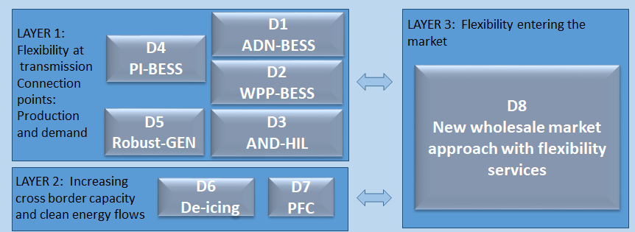
Demonstrators – Layer Division

Slide 10
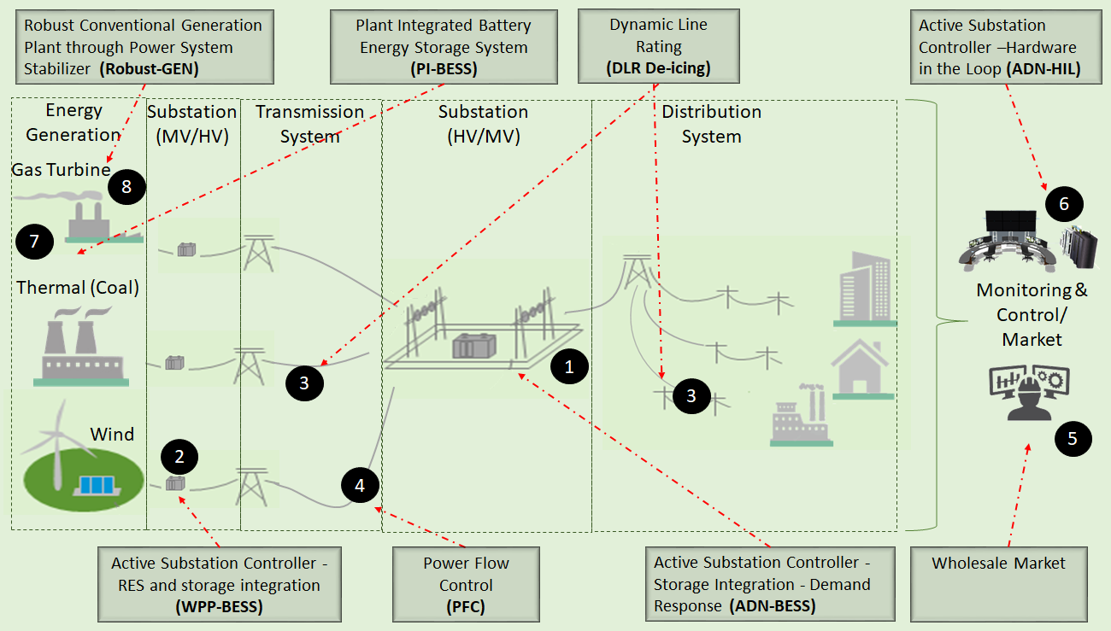
Conceptual Workflow

Slide 11


Slide 12


Slide 13
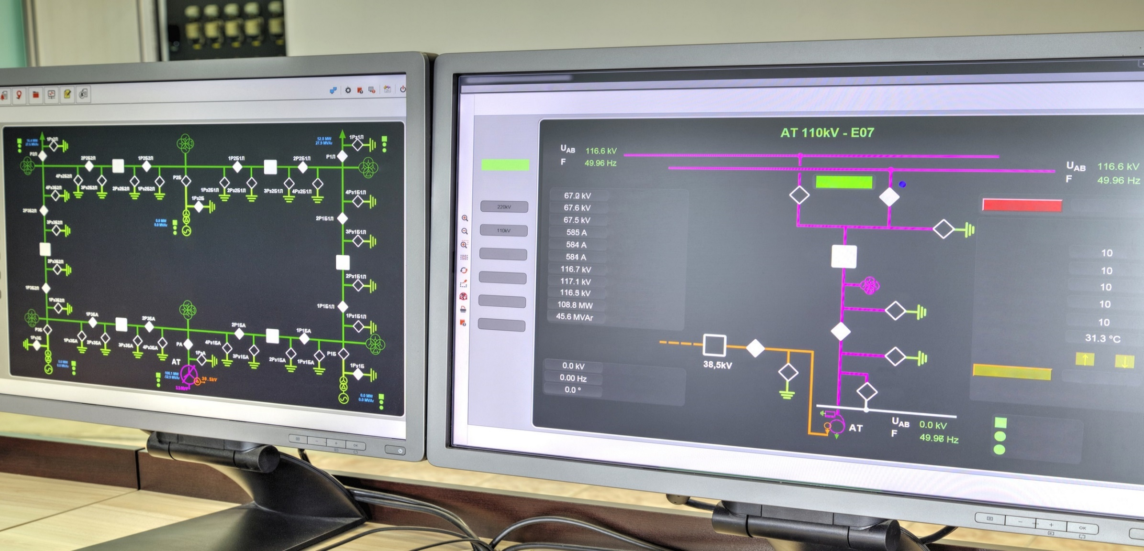

Slide 14
Impact
Develop new policies governing the energy exchange and the energy markets.
Include new actors and players.
Transform the European Internal Energy Market (IEM) according to the framework defined by the ENTSO-E and the ETIP-SNET Roadmaps.
Contribute towards higher RES penetration and CO2 levels reduction.
Utilize available energy and distribute the available capacity more efficiently, thus reducing costs.

Slide 15
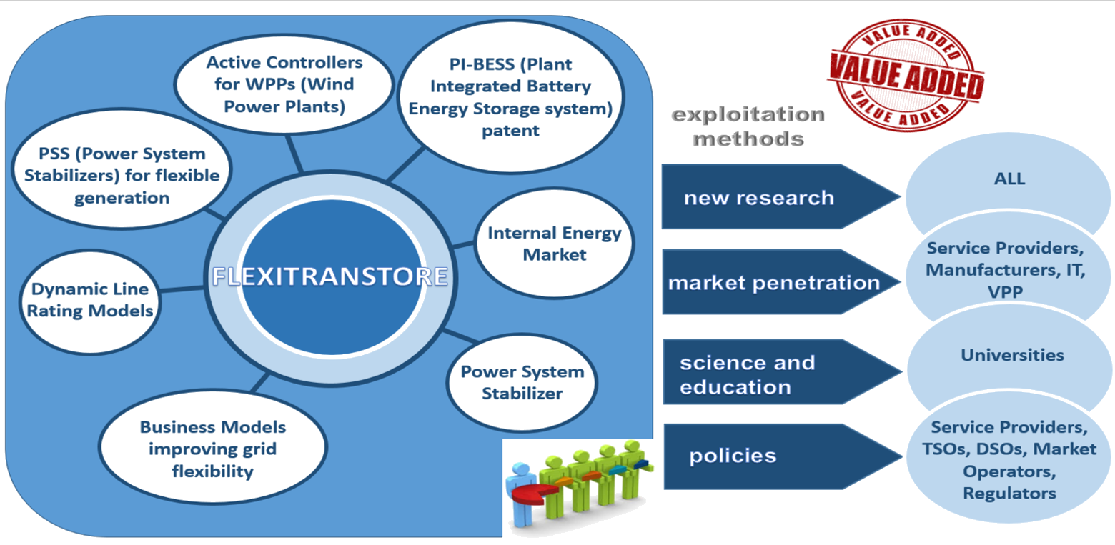
Exploitable Results

Slide 16



























The Partners

Slide 17
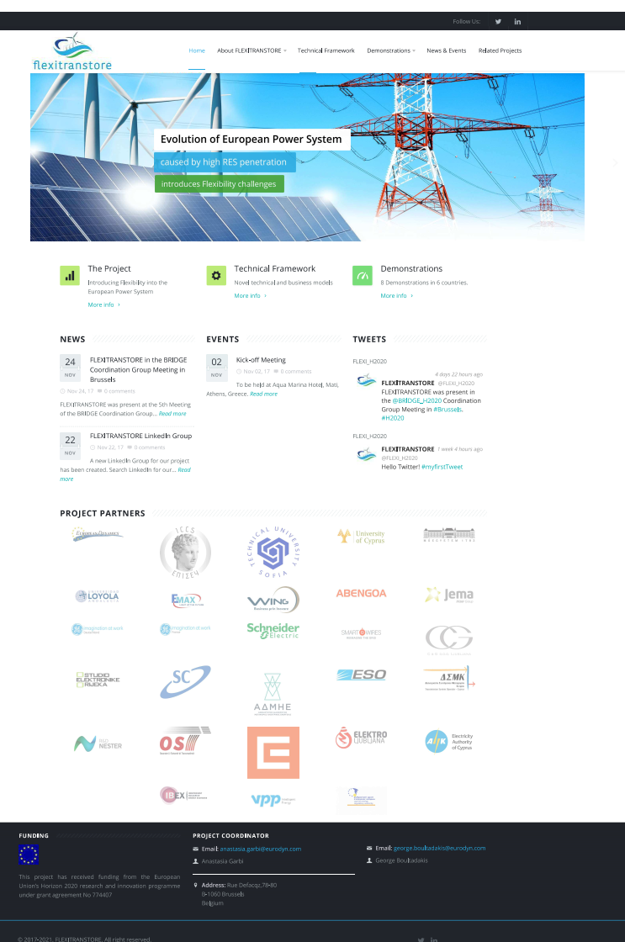




Join us …
www.flexitranstore.eu
FLEXITRANSTORE – H2020 GA No. 774407
@FLEXI_H2020

Slide 18

Questions?
Thank you very much for your attention!!
www.flexitranstore.eu
This project has received funding from the European Union’s Horizon 2020 research and innovation programme under grant agreement No 774407

