Slide 1
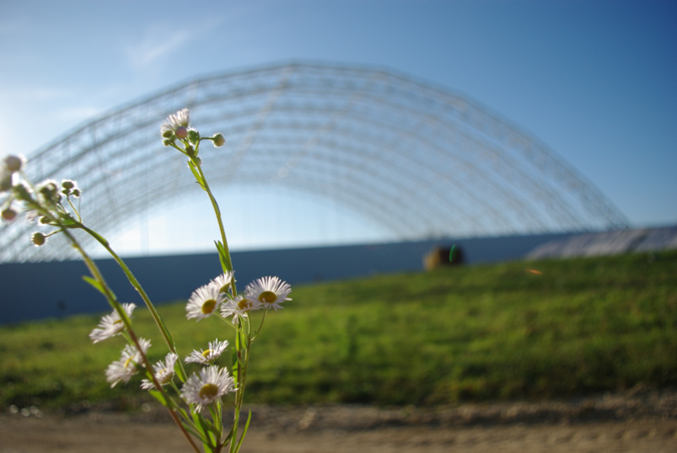
a team of experts – one focus
WASTE to ENERGY, a contribution for reduction of our ecological footprint

Slide 2
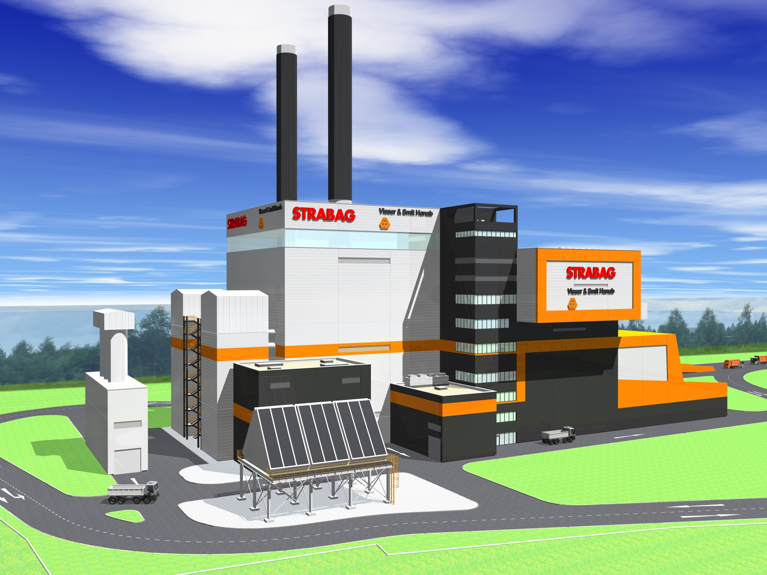
INDEX
HISTORY
KEY FIG. & ADDED VALUE
CORE & GROW MARKET
REFERENCES
VISIONS

Slide 3

HISTORY
ILBAU
1835 => Founding family enterprise „Anton Lerchbaumer“, AUSTRIA
1975 => Founding enterprise „ILBAU Ges.m.b.H & Co.KG“, AUSTRIA
1987 => Founding holding society „BAU HOLDING AG“
STRABAG
1895 => Founding „Straßenwalzenbetrieb“, D
1930 => Launch company trade mark „STRABAG“
1949 => Primary notation „STRABAG AG“ at cologne stock exchange
Consolidation ILBAU & STRABAG
1998 => BIBAG AG aquires majority of STRABAG AG cologne
  2005 => Converting BAUHOLDING STRABAG AG in BAUHOLDING STRABAG SE
  2007 => Converting BAUHOLDING STRABAG SE in STRABAG SE
HISTORY

Slide 4


ORG CHART
Segments
Building Construction & Civil Engineering
Transportation Infrastructures
Special Divisions & Concessions
    Housing
    Commercial and Industrial Facilities
    Public Buildings
    Prod. of Prefabri. Elements
    Civil Engineering
    Bridges
    Power Plants
    Environmental Technology
    Railway Structures
    Roads, EarthworksWorks
    Hydraulic Engineering, Waterways, Dyking, Paving, Asphalting
    Sports & Recreational Materials
    Protective Structures
    Sewer Systems
    Production of Constr. Mat.
    Bridges and Railway Struct.
    Tunnelling
    Ground Engineering
    Real Estate Development
    Infrastructure Development
    Operation/Maintenance/Marketing
    of PPP projects
    Property & Facility Management
Strong brands
HISTORY

Slide 5

HISTORY ENVIRONMENTAL TECHNOLOGY
  1984 => First activities in Germany on environmental business
  1993 => Founding „Züblin Environmental“ Technology G.m.b.H.
  2004 => Founding Sales representative offices in Italy & France
  2006 => Broadening of activities in Romania and Poland
  2007 => Acquisition of 100% of the “Linde KCA Umweltanlagen”
  2007 => Acquisition of 100% of the “O. Klug G.m.b.H.”
  2008 => Acquisition of 43% “h s Group”
  2009 => Assets, skills and know-how transferred from Envirgy GmbH, focused on Flue gas treatmt
  2010 => Acquisition of 100 % “hs energieanlagen”, focused on stationary fluidized bed boiler
  2011 => Co-operation on grate combustion with
HISTORY

Slide 6
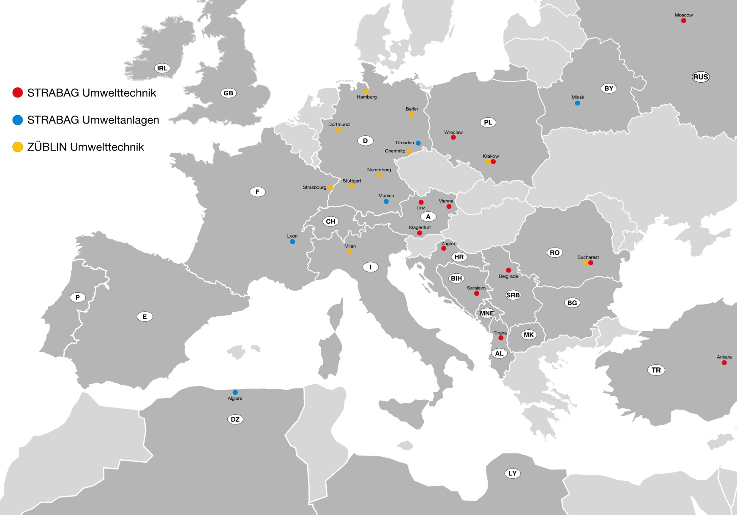
ROAD MAP ENVIRONMENTAL TECHNOLOGY
HISTORY

Slide 7

HISTORY COOPERATION &
For WtE projects with grate combustion technology end of June 2011 STRABAG and Visser&Smit Hanab founded an cooperation agreement for selected markets.
04.2010 => Introduction V&SH to STRABAG Energy Technology
05.2010 => Project cooperation PPP tender, WtE St. Petersburg
01.2011 => Management Meeting STRABAG and V&SH
05.2011 => Project Meeting with emphasis on general co- operation agreement for WtE plants with grate combustion
07.2011 => Signing general co-operation agreement for WtE plants with
ThyssenKrupp Xervon Energy
as nominated contractor for grate combustion techn.
08.2011 => Press release co-operation agreement
HISTORY

Slide 8

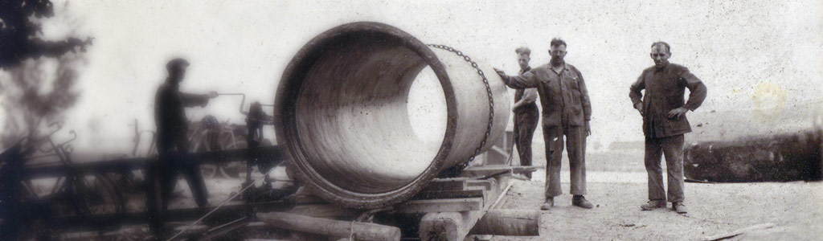
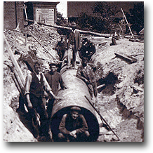
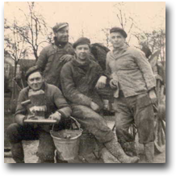
HISTORY
1900 => Founding Visser & Smit, since 1970 part of Adriaan Volker
1945 => Starting trade and construction company HANAB
1972 => entering the Stevin Group
1978 => Visser & Smit and HANAB joined under Visser & Smit Hanab
1997 => Koninklijke Stevin Group joined with Kondor Wessels which resulted in the new company Koninklijke Volker Wessels Stevin. This group became the VolkerWessels Concern.
HISTORY

Slide 9


KEY FIGURES STRABAG & V&SH
Description |  |  | In Total
# of employees 2008 | 73.008 | 17.800 | 90.808
# of employees 2009 | 75.548 | 16.599 | 92.199
# of employees 2010 | 73.600 | 16.551 | 90.151
Total output 2008 (€ Mio) | 13.742 | 4.874 | 18.616
Total output 2009 (€ Mio) | 13.021 | 4.419 | 17.440
Total output 2010 (€ Mio) | 12.777 | 4.250 | 17.027
Equity ratio 2008 (%) | 30,50 | 29,00 | -
Equity ratio 2009 (%) | 32,20 | 29,00 | -
Equity ratio 2010 (%) | 31,10 | 27,00 | -
Equity invested in PPP 2010 (€ Mio) | 375 | 0 | 375
# of PPP Projects 2010 | 33 | 0 | 33
KEY FIGURES &
ADDED VALUE

Slide 10
KEY FIGURES – ADDED VALUE
Scope / Facilities | FBC Technology ^{*1} | Grate Technology
Civil Construction | STRABAG + V&SH | STRABAG + V&SH
Mechanical-biological Treatment | STRABAG | Not required
Combustion | STRABAG | TKXE
Boiler | STRABAG | V&SH
Combined heat & power cycle | External | External
Flue gas treatment | STRABAG | STRABAG
Electric, instrument. & controll system | External | External
Supervision mech. erection, Commissioning | STRABAG | STRABAG + V&SH
Engineering & Project Management | STRABAG | STRABAG + V&SH
Waste Collecting System & Landfill Construction & Re- Constr. | STRABAG and Local partner | STRABAG and Local Partner
Operation & Maintenance | STRABAG, V&SH and Local Partner | STRABAG, V&SH and Local Partner
Project Development & Financing | STRABAG + V&SH | STRABAG + V&SH
STRABAG + V&SH added value in % | > 75 % of total EPC | > 65 % of total EPC
^{*1} FBC – Fluidized Bed Combustion, STRABAGS own core technology
KEY FIGURES &
ADDED VALUE

Slide 11
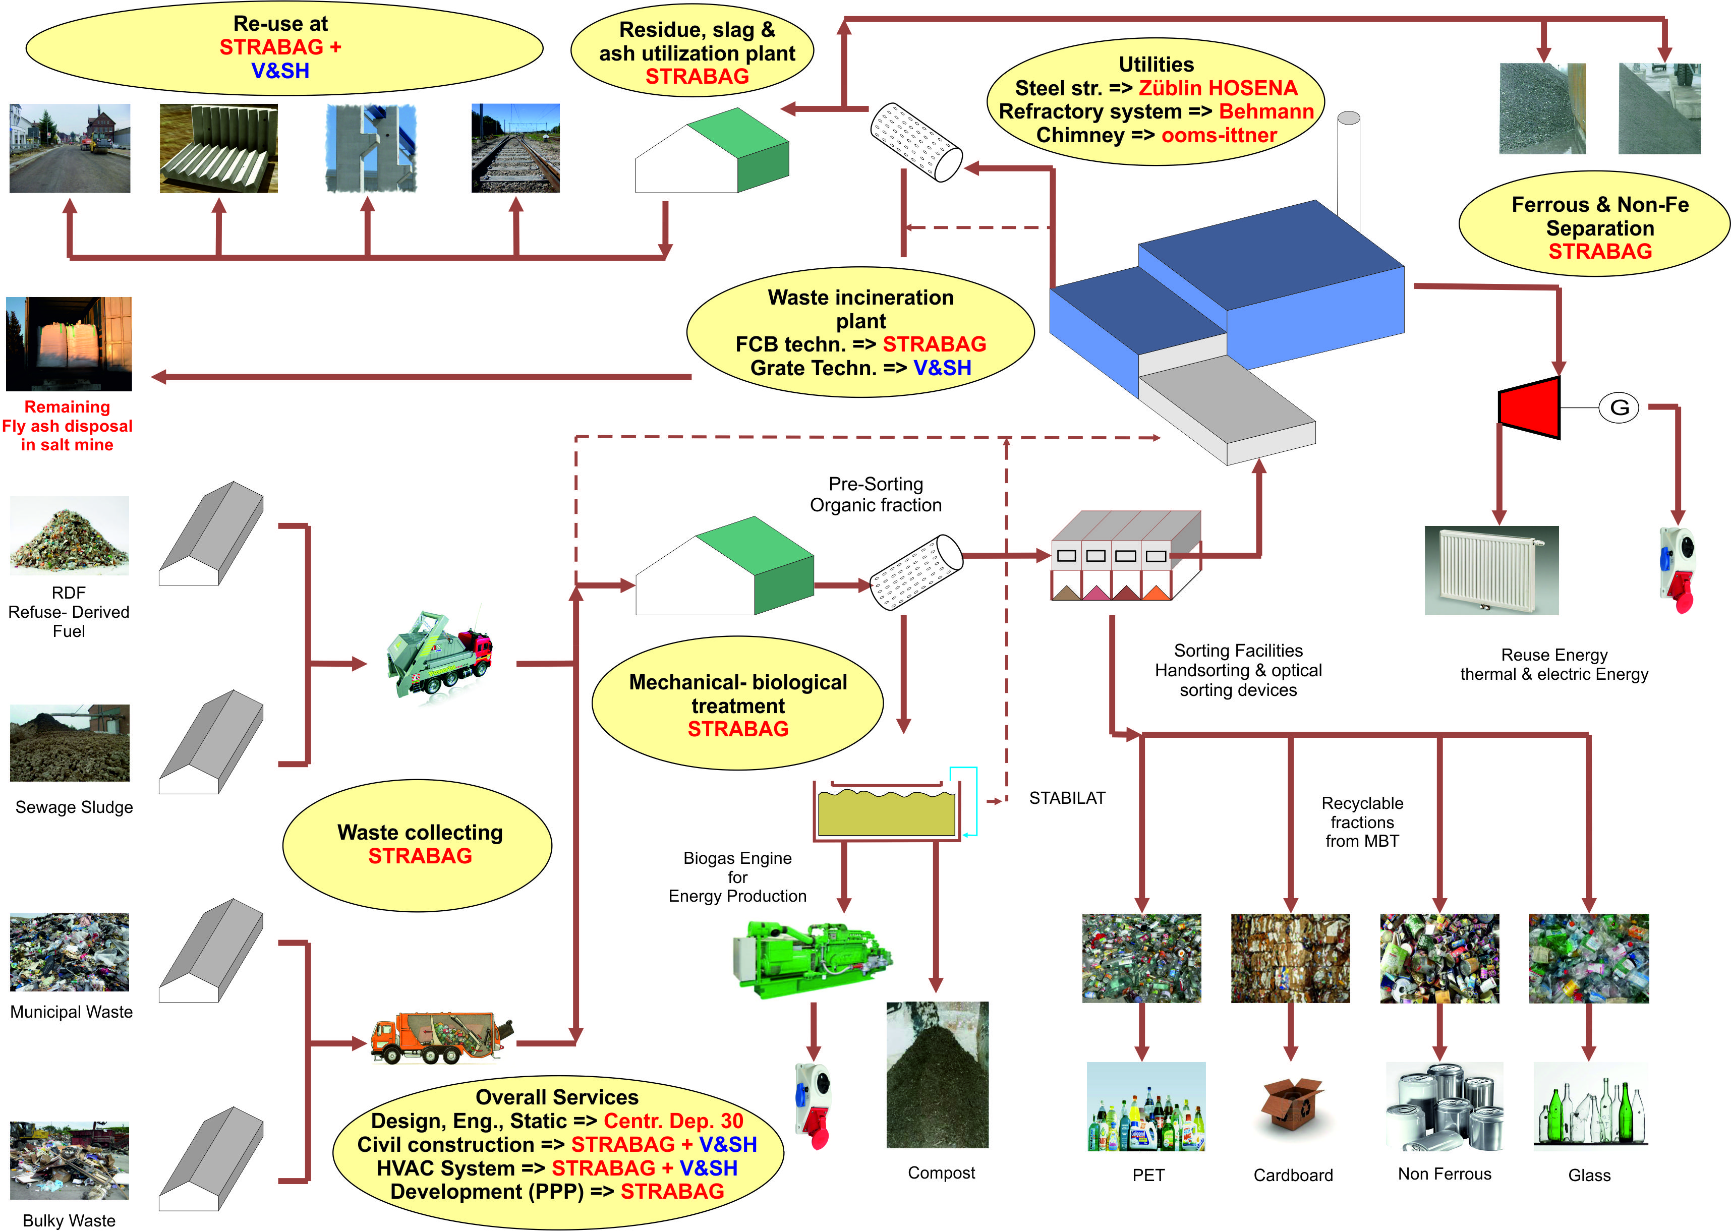
KEY FIGURES TYPICAL PROJECT - ADDED VALUE
KEY FIGURES &
ADDED VALUE

Slide 12
CORE & GROW MARKET
in total approx. 495 facilities and approx. 83,50 Mio. mg/a
Country | DE | UK | FR | IT | ES | NL | PT | CH | GR | BE | AT | SE | DK | NO | IE | FI | LU | IS
No. of plants | 99 | 26 | 137 | 54 | 13 | 12 | 3 | 30 | 0 | 19 | 11 | 31 | 37 | 18 | 0 | 3 | 2 | 0
Total cap. Mt/a | 26,8 | 6,10 | 15,6 | 5,3 | 2,6 | 7,6 | 0,7 | 3,6 | 0 | 2,8 | 2,4 | 3,9 | 3,5 | 1,6 | 0,2 | 0,5 | 0,3 | 0
CORE & GROW
MARKET

Slide 13
CORE & GROW MARKET
Existing and ordered WtE Cap. in Central & Eastern Europe and further markets
in total approx. 18 facilities and approx. 4,03 Mio. mg/a
Country | RU | TR | PL | UA | RO | HU | BY | BG | CZ | YU | HR | SK | LT | BA | SI | LV | MK | EE
No. of plants | 4 | 0 | 1 | 2 | 0 | 1 | 0 | 0 | 4 | 0 | 0 | 2 | 2 | 0 | 1 | 0 | 0 | 1
Total cap. Mt/a | 1,4 | 0 | 0,1 | 0,4 | 0 | 0,53 | 0 | 0 | 0,87 | 0 | 0 | 0,3 | 0,3 | 0 | 0,03 | 0 | 0 | 0,1
CORE & GROW
MARKET

Slide 14
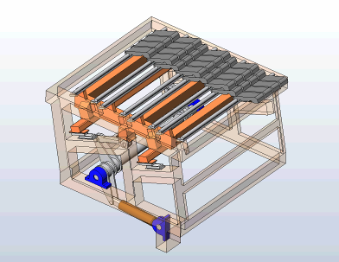
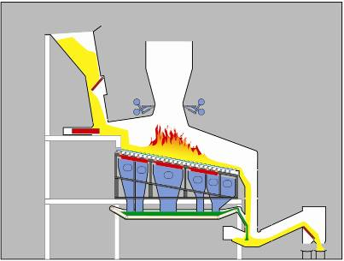
GRATE COMBSUTION Technology
ThyssenKrupp
General scheme – air cooled reciprocating grate
General plant view
Grate bars (movable)
Grate bars (fix)
Feeding
System
Control
Concept
Grate table
Post Combustion
Chamber
Secondary Air
System
Combustion
Chamber
Rost
Deslager
Bearing
Hydraulical cylinder
Promary Air
System
Standard grate module
System „Xervon Energy“
REFERENCES
14
© STRABAG SE 10/2011
Notes:
14

Slide 15
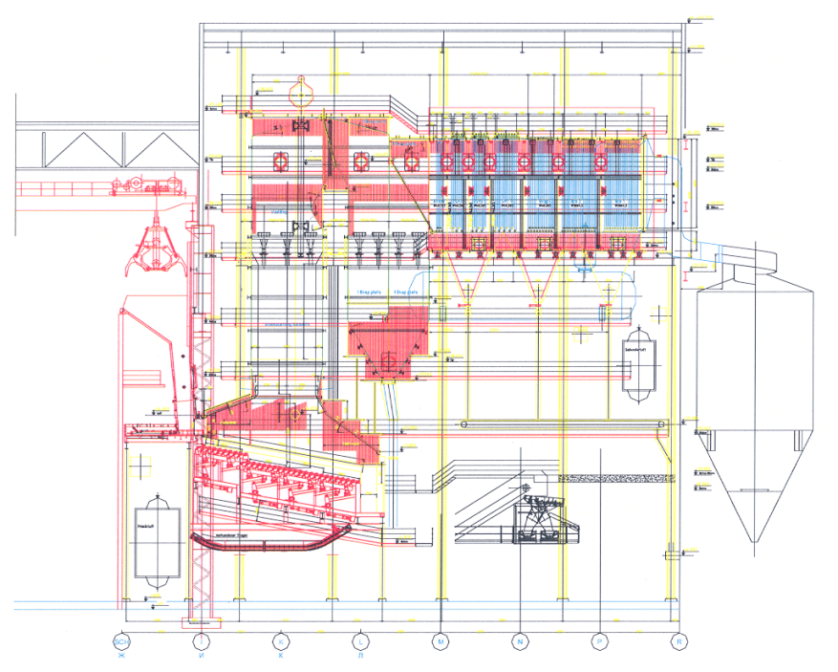
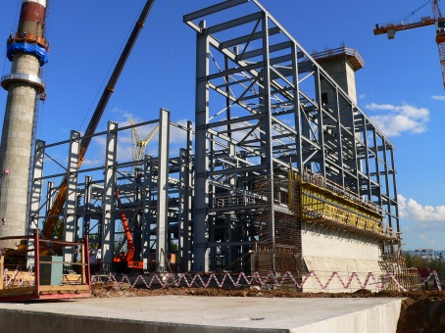
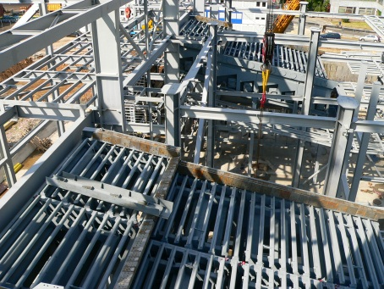
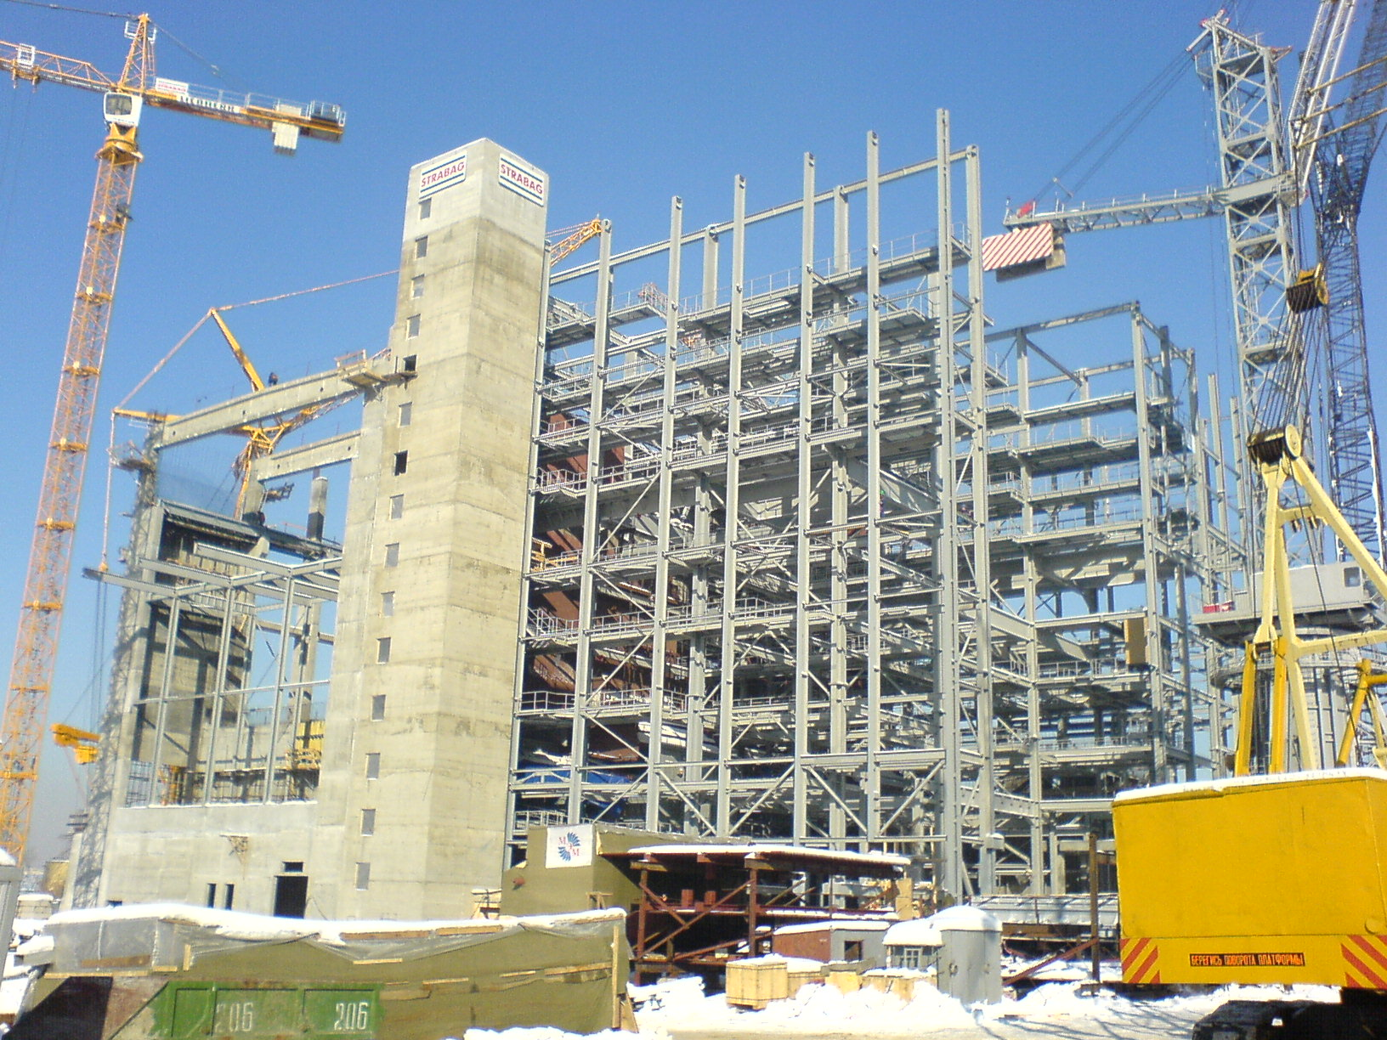
REFERENCE – MSZ3 MOSCOW
ThyssenKrupp
Project data
Realization 2004 - 2008
Scope:
New firing system incl.
air cooled moving grate
ignition and auxiliary firing system
Municipal solid waste & natural gas
2 lines with a capacity
Boiler 2 x 46 MW_{th}
Steam flow: 2 x 58 Mg/h
Operating pressure 37 bar
Steam temperature 360 °C
REFERENCES
15
© STRABAG SE 10/2011
Notes:
15

Slide 16
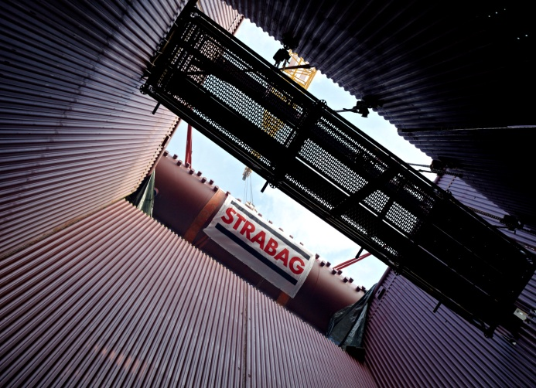
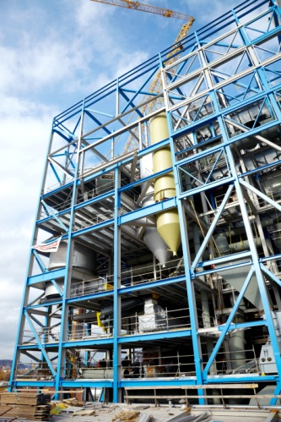
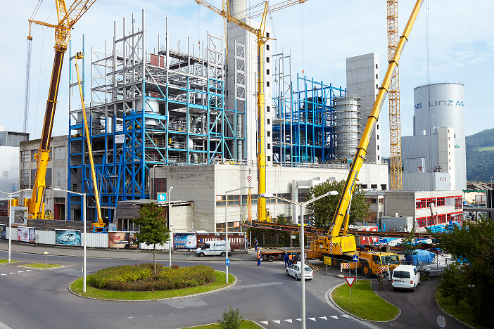
REFERENCE - RDF FCB BOILER, 66 MWth
Project data
Supply, erection and commissioning of a bubbling fluidized bed boiler for the combustion of RDF & sewage sludge
Designed for up to 31% of sewage sludge content in the fuel
Modular construction and erection concept
Fuel treated household- and industrial waste, sewage sludge, screenings
Live-steam output: 90 Mg/h
Live-steam pressure: 42 bar_{a}
Live-steam temperature: 405 °C
Heating value: 6 – 13 MJ/kg
Commissioning: 2011
REFERENCES

Slide 17
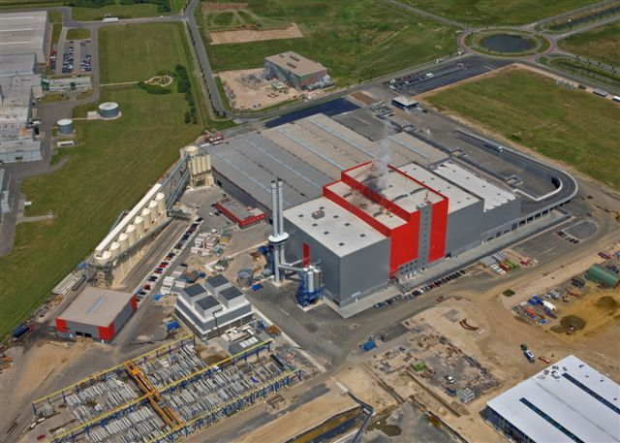
REFERENCE – WTE EVI EUROPARK
Project data
In operation : since 2008, Germany
  V&SH scope : Steam Boiler incl. Grate Firing System and Auxiliaries
  Thermal load : 2 x 76 MW (360.000 t/a)
  Steam param.: 60 bar / 460°C
  Electrical outpt.: 47 MW
  total efficiency: approx. 31%
REFERENCES

Slide 18
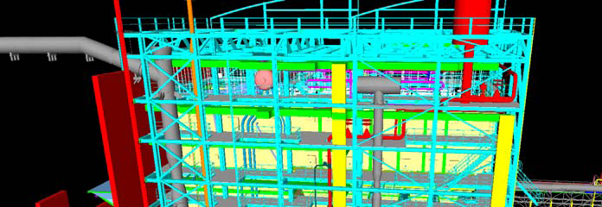
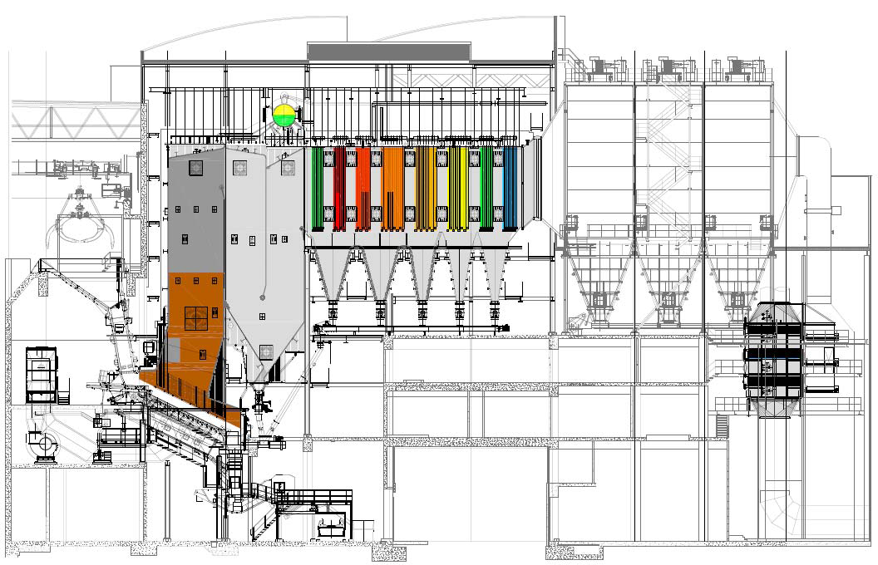
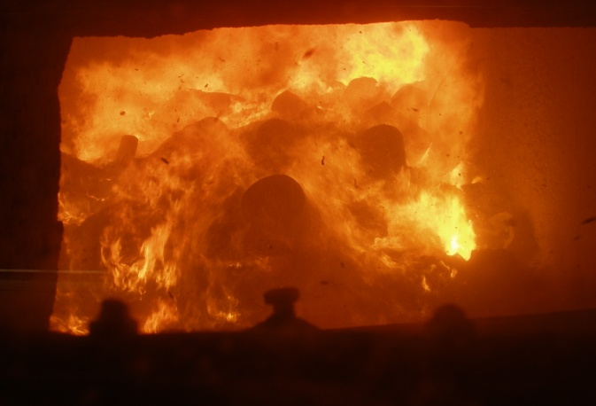
REFERENCE – WtE HVC DORTRECHT
Project data
V&SH Scope: Boiler and Pipe work
Thermal load: 1 x 75 MW
Fuel capacity: 225.000 Mg/a
Steam outpt.: 1 x 94 Mg/h
Steam paramt.: 42 bar / 400°C
Start of operation: since 2010
REFERENCES

Slide 19
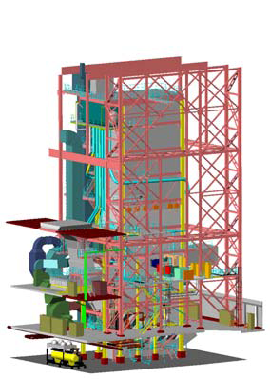
REFERENCE RETROFIT AVR ROZENBURG
Project data
Realization: 2005 – 2007
Scope:
new design furnace-boiler
new inconel cladded walls
new SH and ECO, waste feeding system
Installation & commissioning
3-shift to minimise downtime
Project tasks:
minimizing CO emissions
increasing waste throughput →
increase steam output
from 56 to 70 Mg/h per line
REFERENCES

Slide 20
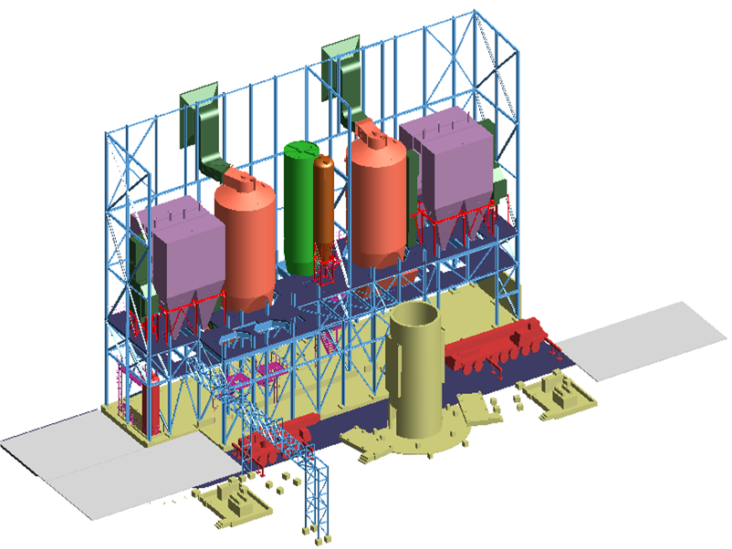
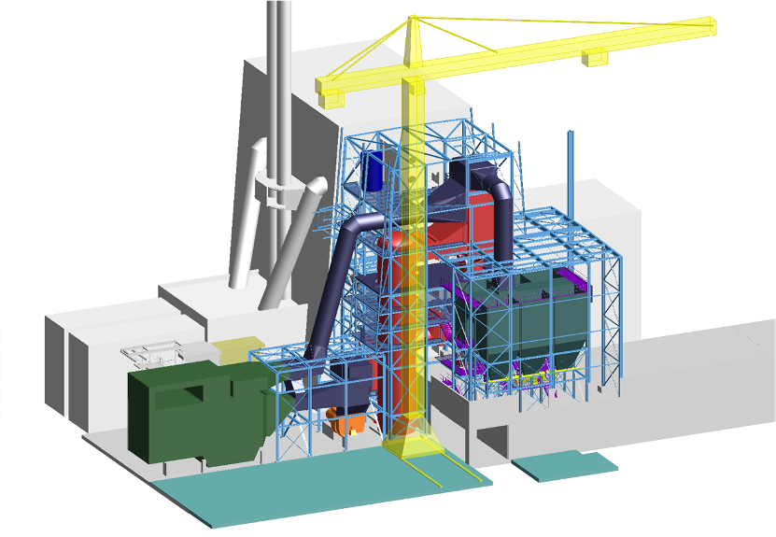
REFERENCES FLUE GAS CLEANING
Project data, MSZ3 Moscow
Realization: 2004 – 2008
Scope:
complete flue gas cleaning system
Semi dry absorber, fabric filter, SCR
Activated carbon and bicarbonate system
2x120.000 Nm³/h
Project data, Dürnrohr Line 3
Realization: 2005 – 2009
Scope:
complete flue gas cleaning system
fabric filter, 2-stage wet scrubbing, SCR
heat exchangers
1x170.000 Nm³/h
REFERENCES
20
© STRABAG SE 10/2011
Notes:
20

Slide 21
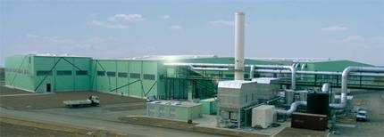
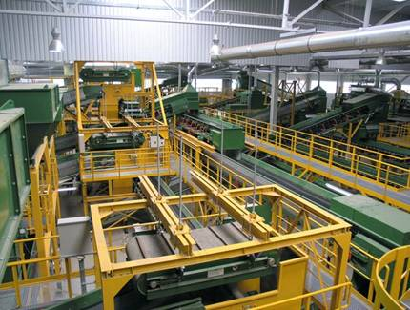
REFERENCE MBT, SITA Ost, Leipzig - D
Project data
Realization: 2005 – 2007
Scope:
Mechanical-biological waste treatment
Plant Capacity 300.000 Mg/a
flat bunker, shredding, screening, wind sieving
ferrous and non ferrous metal separation
ballistic separation
post shredding
plastic separation and compacting
Intensive composting realized with 44 tunnels with automatic filling and discharge
Post composting executed as aerated windrow process with mobile compost turner
Exhaust air treatment by humidifier/ biofilter and chemical scrubber/regenerative thermal oxidation
REFERENCES
21
© STRABAG SE 10/2011
Notes:
21

Slide 22
REFERENCES - SELECTED PPP PROJECTS
STRABAG | Country | Project Value
A2 Motorway (Phase 1) | Poland | € 880m
Euphrate Power Barrage at Birecik | Turkey | € 1,156m
M5 Toll Motorway (Phases 1, 2 and 3) | Hungary | € 973m
Motorway Zagreb-Macelj (Phase 1) | Croatia | € 370m
Fermoy Bypass Toll Motorway | Ireland | € 210m
A2 Motorway (Phase 2) | Poland | € 1.530m
Limerick Southern Ring | Ireland | € 433m
M6 Motorway (Phase 3) | Hungary | € 956m
A5 Motorway | Germany | € 400m
M51 Motorway | Denmark | € 150m
A15 Motorway | Netherlands | € 730m
A8 Motorway | Germany | € 585m
REFERENCES

Slide 23
STRABAG Energy Technologies GmbH
a team of experts with one focus
Waste to Energy
YOUR serious partner with strong financial background, international network as well as long-term history in worldwide realization of infrastructure projects.
STRABAG and partners are prepared to assist’s YOU in
development & financing
as well as
construction & operation
of all of YOUR projects in waste management services and therefore also reducing the CO2 footprint.
VISIONS

Slide 24
For further questions please contact:
STRABAG Energy Technologies GmbH
Floridsdorfer Hauptstrasse 1-7
1210 Vienna / AUSTRIA
Mr. Andreas Richter
Head of Sales Development - WtE
Tel.: +43 (0) 1 60 33 680 - 126
mob.: +43 (0) 676 79 14 305
email: andreas.richter@strabag.com
web.: www.strabag.com
!!! Thank you for your attention !!!
VISIONS
24
© STRABAG SE 10/2011
Notes:
24

