Slide 1

VACUUM GASIFICATION OF WASTE – ENVIRONMENTALLY FRIENDLY AND COST EFFICIENT CONTRIBUTION TO THE CIRCULAR ECONOMY
2015 - EU action plan for the Circular Economy
2018 - Revised legislative framework on waste has entered into force
More than 500 million tons of greenhouse gas could be avoided between 2015 and 2035, directly by cutting emissions from landfills and indirectly by recycling materials.
On 4 March 2019, the European Commission adopted a comprehensive report on the implementation of the
Circular Economy Action Plan.

Slide 2
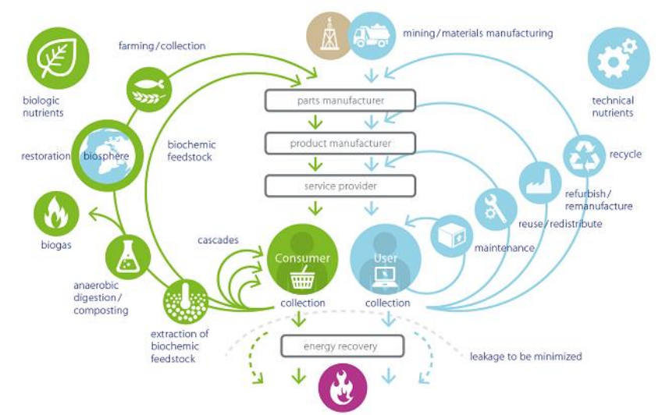

The Circular Economy
is an economic model
wherein planning,
resourcing, procurement,
production, reprocessing
are designed and
managed, as both
process and output,
to maximize ecosystem
functioning and human
well-being
Circular Economy System Diagram (Ellen MacArthur Foundation, 2015)

Slide 3
Revised EU waste proposal - Transition from linear to circular eonomy include:
A common EU target for recycling :
65% of municipal waste by 2035;
70% of packaging waste by 2030;
Recycling targets for specific packaging materials:
  Paper and cardboard: 85 % Ferrous metals: 80 %
  Aluminium: 60 % Glass: 75 % Plastic: 55 % Wood: 30 %
Binding landfill target to reduce landfill to maximum of:
10% of municipal waste by 2035;
Separate collection obligations strengthened and extended to :
Hazardous household waste (by end 2022), bio-waste (by end 2023), textiles (by end 2025).

Slide 4
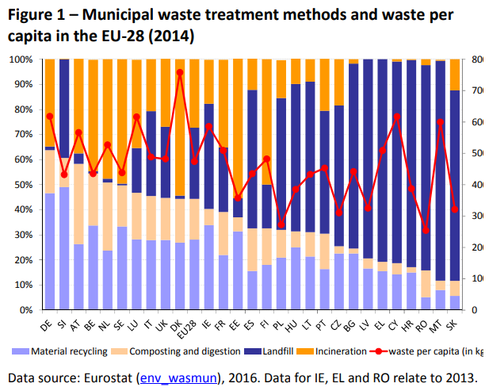
Landfilled waste in EU by countries
Zero landfilled : Germany, Belgium, Netherlands, Sweden
- 70-90% landfilled : EU countries East from Czech Republic
Bulgaria

Slide 5
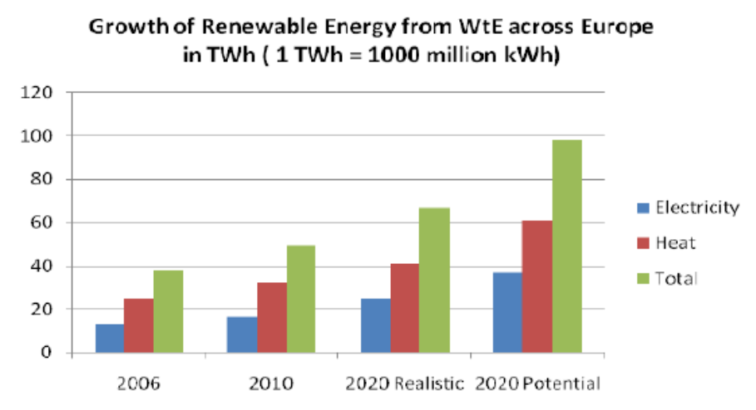
The interconnected phenomena that is happening on our planet :
The need for energy and the problem of waste.
Energy and waste policies and systems share mutual concern:
Environmental impacts that include reductions of GHG, soil contamination, and water contamination.
The problem of waste is an answer to energy needs. WTE has become one of the most commonly used technologies in Europe used to address waste management with municipal solid waste

Slide 6
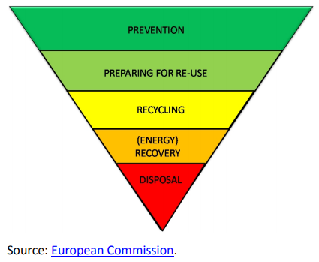
Non-recyclable waste – a source of cheap renewable energy
- Residual biomass from forestry, parks, agriculture, animal and chicken farms
Waste from food, paper, building, oil, pharma,
light, chemical and processing industries
- Residual Derived Fuel (RDF) from municipal
waste separation plants
- Sludge from waste water treatment plants
Domestic waste from non-metal furniture,
organic and synthetic textile,
non-metal waste from end-of-life vehicles
Bone/meat waste from meat industry
And more….as the hydrocarbons are all around.
The more energy recovery, the less landfilled waste

Slide 7
Waste-to-Energy technologies
Burning (incineration, oxidation) and heat utilization
Thermal decomposition (pyrolisis, gasification, plasma gasification) synthetic oil and gas utilization
Incineration vs Gasification: Comparison chart based on same capacity of feedstock:
Parameter | Incineration | Gasification
Energy efficiency | 55% | 95%
Air burning oxidation - dioxins, furans, fine particles | Yes | No
Size of equipment, CAPEX, operation costs | 100% | 60%
Time period for design, delivery, start | 100% | 50%
Modular design, flexibility for resizing, optional mobile version | No | Yes
Hazardous residual for landfill | Yes | No
Precise process control , option for remote/postponed use of the energy | No | Yes

Slide 8
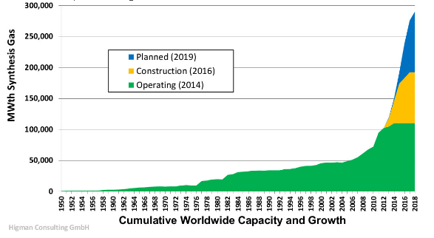
Gasification plants for waste worldwide
Although the gasification as thermal decomposition technology is not new, it shows rapid development in the last 4-6 years.
At the same time many incineration plants are closed in USA and EU, projects for new incinerators are cancelled. The new WtE projects are mostly gasifiers.
Main reasons for this trend are both ecological and economical, as seen in the comparison chart.

Slide 9
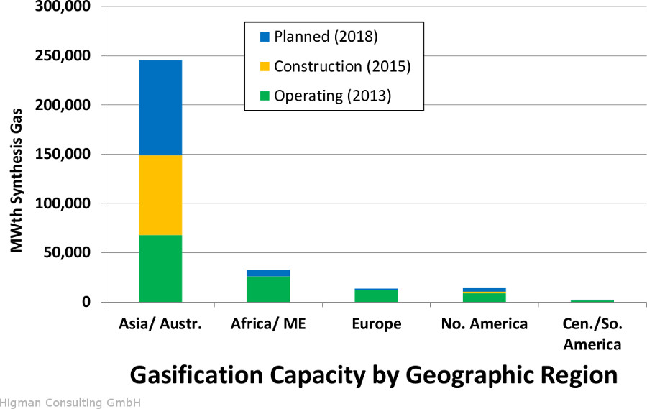
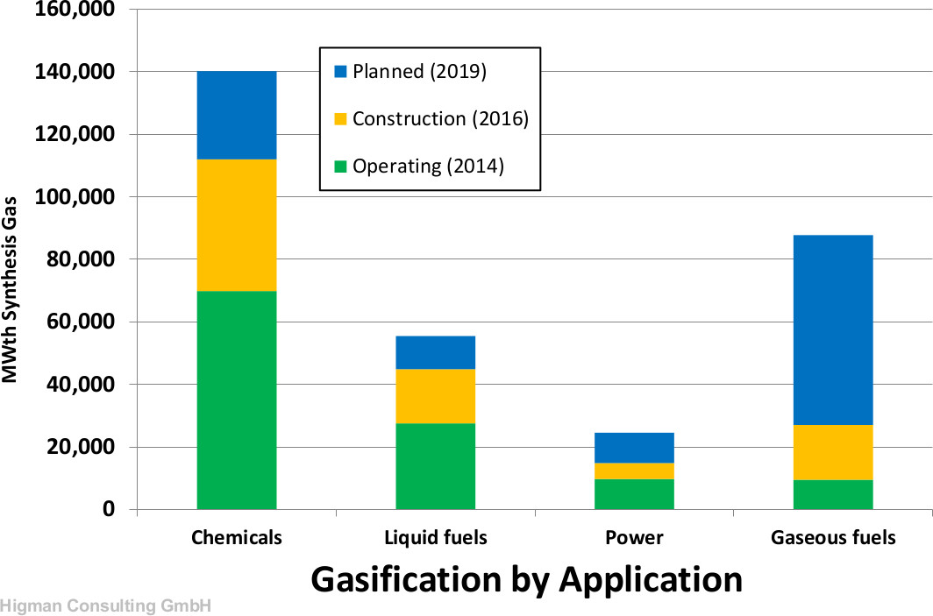
The Gasification Industry (2013)
- Worldwide - 272 operating gasification plants with 686 gasifiers.
74 plants under construction worldwide with a total of
238 gasifiers to produce 83 MWth.
33 gasification plants in the United States , 110 in Japan
Asia/Australia: Increase of natural gas prices boosts gasification for chemical, fertilizer, and coal-to-liquids industries
China has the largest number of gasification plants, incl. coal-to-syngas.

Slide 10
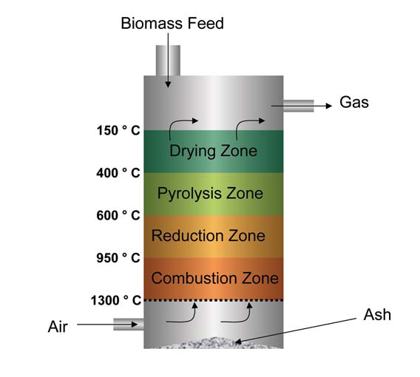
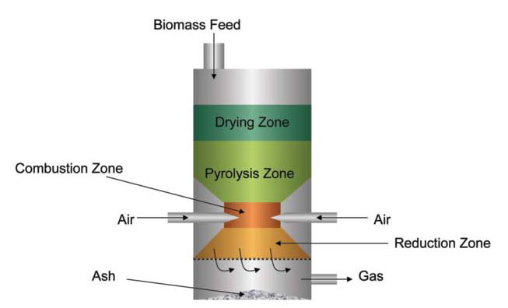
Different WtE gasification technologies
Heating of feedstock:
-Direct - internal
-Indirect - external
Configuration:
-downdraft fluidized bed
-updraft
-entrained bed
-auger driven horizontal,
stand-alone syngas output
Air access:
-with limited air access Direct feedstock heating : Syngas - heat – steam - power
-no air access
-negative pressure (vacuum)
Stages:
- Single chamber gasifier
- Two chambers gasifier
-Three zones gasifier
Plasma gasification:
-High temperature plasma torch Indirect feedstock heating (vacuum gasifier) :
- Syngas as clean fuel – gas turbine, gas engine – power, heat.
- Transportable fuel.

Slide 11
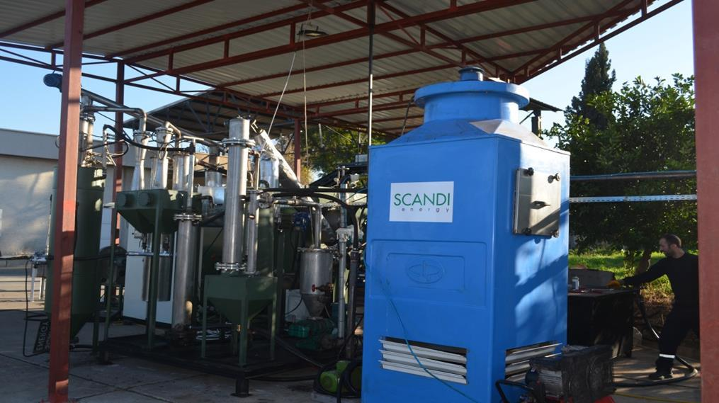
Energy recovery by vacuum gasification: zero landfilled waste
Two stage gasification
Stage 1: Pyrolisis gasification at 450 deg C - no air
Stage 2: Steam added gasification at 860 deg C – no air, boost hydrogen contents of syngas
Syngas treatment - cleaning, cooling
Syngas burning in power genset
Flue gas recirculation for feedstock heating
Energy efficiency with cogeneration – 85-90%

Slide 12
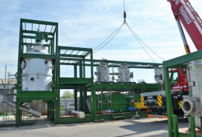
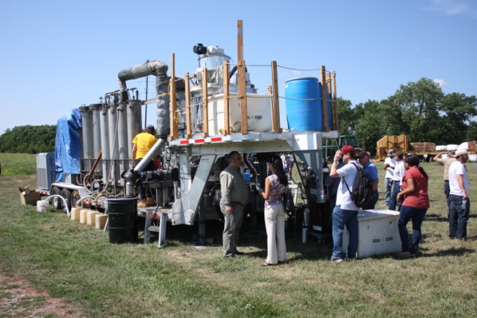
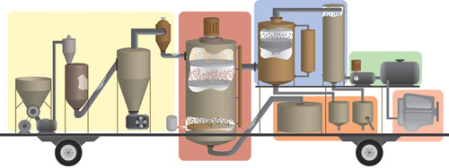
Distributed waste-to-energy plants - practical solution for small scale and mobile gasification plants
The gasification technology is flexible to offer:
Fast and easy design and construction
Mobile installation for local needs

Slide 13
Waste-to-Energy technology in Bulgaria
With zero WtE plants in 2019, Bulgaria can be considered an open and full of opportunities market for the technology / equipment vendors.
For the Bulgarian state institutions, responsible for the environmental protection, municipalities and public structures related with the energy supply, this can be the best opportunity to select the best up-to-date and innovative technologies. No need to spend on modernization of existing old plants, with low efficiency and environmental standards.
The proper national strategy should be based on:
Expert analysis of the existing technologies and expertise
Choosing the most efficient and optimal solutions to suit the needs
-Integral approach in accounting all aspects of each project
-Vision for the future, planning based on scientific forecasts regarding environment, industry and society.

Slide 14

Thanks for your attention
Lubomir Dimitrov, Dipl. Eng.
l.dimitrov@edimit.com
Ph.+359888551181
CEO, Edimit Ltd
WtE Business Consultants

